Slide 1
The Art of an Effective Internal Investigation, Data Privacy, EPLI Market Update, and Changes to the Law of Arbitration Agreements
Presented by:
Felice B. Ekelman, Esq., Jackson Lewis P.C.
Michelle E. Phillips, Esq., Jackson Lewis P.C.
Neil Owens, E.B. Cohen
September 10, 2019

Slide 2
Why Is An Effective Investigation Important?
Allows the Company to make informed decisions
Encourages an open workplace where employees are comfortable raising issues
Discourages improper behavior
Resolves workplace issues before an outside entity becomes involved
Contemporaneously locks in facts
Provides the Company with effective defenses

Slide 3
You receive a new complaint, what’s next?
What can trigger an investigation?
A complaint by an employee
A complaint by a third-party
A complaint by another employee about someone else they believe is being subjected to inappropriate conduct
If you hear or overhear about inappropriate conduct, but nobody has complained to Human Resources
Whenever the Company is on constructive or actual notice about conduct that may violate a Company policy
Notes:
Note: Return back to the example?

Slide 4
Investigation Trigger Words
Discrimination
Harassment
Retaliation
Threats
Intimidate
Misconduct
Contract violations
Wage-hour violations
Unfair Treatment based on race, gender, age, disability, sexual orientation, religion, age or another protected group
Property Theft/Harm
Alcohol/Drug Use
Annoy/Bother
Hostile
Unsafe
Uncomfortable
Creepy/Weird
“It felt off”
“It didn’t seem right”

Slide 5
What if….
What if the victim did not directly make the complaint?
What if the victim does not want to file a complaint with the Company?
What if the victim says they “don’t want to do anything formal or make a big deal” but “just want you to be aware?”
What if someone else tells you they aren’t sure but they think they saw someone do something inappropriate?
Notes:
What if the victim did not directly make the complaint: does not matter, still need to investigate (refer back to our example)
What if the victim does not want to make/participate in the complaint: does not matter, sill need to investigate but can note that person did not want to cooperate
TAKEAWAY: Always must investigate, even

Slide 6
Planning the investigation

Slide 7
Determine Who Will Conduct The Investigation
Who is the “Best Fit” to Handle the Case?
Consider organizational issues
Who does the complaint involve?
Who reports to whom?
Consider internal or external counsel
HR Team / Internal Investigation
External Counsel
Third-Party Investigator
Notes:
You cannot have somebody that will behave unprofessionally or outrageously. It can open up to a potential IIED claim
Consider gender if sexual conduct is alleged, ethnicity if racial/ethnic conduct alleged, hierarchy based on the level within the organization the conduct affects

Slide 8
Prepare The Investigation File
Identify those who may have information pertinent to the complaint
Determine positions held, job duties, and relationship between complainant/accused
Are the employees covered by a CBA?
Upjohn warnings
Identify the issues
For each allegation, the factual issues must be identified
Understand the issues to be investigated
Potential Witnesses
Complainant
Accused
First-hand witnesses who saw/heard alleged misconduct
Second-hand witnesses who may not have seen/heard, but who may have information
Coworkers
Others identified during the investigation
Customers
Vendors
Notes:
The rights of unionzed employees to have representation at investigatory interviews was announced by SCOTUS in 1975 case: NLRB v. Weingarten, Inc.
Weingarten ruled that union employees are often entitled to representation, especially if the information provided may become the basis for discipline. The employee is NOT entitled to representative of his/her chosing
Non-unionized employees that request an attorney present. No requirement to allow for one.
Ensure the issues are framed in alignment with policy requirements
Remember, issues will evolve with investigation

Slide 9
Prepare The Investigation File
Estimate the Investigation Schedule
Does the Company have a time requirement for completing investigations?
A “prompt” investigation concludes within a reasonable period of time consistent with the scope of the investigation and the significance of the issues
The longer an investigation is open, the more difficult it is to resolve
Pre-Investigation Measures
Consider whether to place the accused on immediate leave
Try to avoid placing the alleged victim on administrative leave unless requested
Do not transfer alleged victim
Consider safety and compliance issues
Notes:
Purposes of pre-investigation measures is to take any necessary immediate action:
To avoid further harassment/injury
Separate employees involved(schedule changes/LOA).
Threat of imminent physical harm?
To protect integrity of investigation
Warn accused and others about retaliation against complainant
Warn against destruction of evidence
To protect Company property
Control access to information systems or sites
Consider temporary removal from the workplace

Slide 10
Identify And Collect Other Evidence
Identify and Preserve all Relevant Documents
Written Complaint
Applicable policies and practices
CBA for unionized workers
Any regulatory or oversight committee policies
Determine if any documents or videos are “missing”
Collect fact information
Hard copy documents (e.g. letters)
A majority will likely be ESI (e-mails, voicemails, calendars, internet history, text messages, computer hard drives, social media, etc.)
Take adequate measures to ensure preservation of evidence
Other Information Systems
Surveillance videos
Access devices (e.g. card readers, key pads)
Or security sign-in sheets
Vehicle tracking devices
Timekeeping system
Payroll system
Receipts
E-mails
Complaint hotlines
Notes:
Get prior relevant investigation files
Get prior relevant complaints
Get personal files of the individuals involved
Complainant’s performance reviews
Collecting information – ensure the company already has a policy in place that allows the searches (both physical and computer) at the worksite, that specifies the degree of searches that can be conducted (employee’s car, desk, personal briefcase, handbags, lockers, on their person, etc.) Obtain a signed acknowledgement of this policy. Legally, courts balance employees’ reasonable expectations of privacy against employer’s reason for the search.
Consider non-documentary evidence or other sources
Is there a piece of equipment or vehicle that malfunctioned and must be inspected and photographed?
Are screen shot images possible to retrieve to identify a fraud trail?
Preservation of evidence: remove any auto-delete procedures if necessary
Chain of custody
Keep all investigative files in a secure area (not all of HR needs access)
Work with IT to prevent inadvertent loss of data due to upgrades and maintenance
Text messages and voice mail (e.g., VOIP systems)
Paper documents and other physical evidence
Consult with legal regarding whether it is necessary to put litigation holds in place.

Slide 11
Have A Separate Investigation File
Documentation of the investigation should be segregated from the personnel file and should include
The employee complaint
Relevant polices
Any documents reviewed
Other documents and notes recorded or memorialized during the investigation

Slide 12
Conducting the investigation

Slide 13
Conducting Interviews
Always Interview
Complainant(s)
Key Witnesses
Accused
Re-interview witnesses if necessary
Consider Preparing Rough Outline/Checklist for Each Interview
Each situation demands different questions
Timeline format with circling back generally works
General Rules for All Interviews
Ask open-ended questions, then specific follow-ups
The 5 W’s
Closed-ended questions for detailed and yes/no issues
Ask for corroborating evidence/witnesses
Pay attention to gestures and other non-verbal clues
Document the facts, not your opinions
Promise nothing / avoid oral agreements
Do not ever lock a witness in a room or block his or her exit
Notes:
If two interviewers, decide who will ask questions and who will take notes. Either laptop and notepad
Laptop: saves transcription time, improves accuracy, enables easier “scroll back” of testimony, enables printing of a witness statement
Open ended questions
What knowledge does the witness have?
Get source of knowledge - HOW DO YOU KNOW THAT IS TRUE?
When asking questions, be patient and allow witnesses to respond
Ask the tough questions, but save embarrassing and unfriendly questions for the end, avoid witness becoming defensive too early
Don’t ever say “we’re not leaving here until you tell us…” It opens up to a potential false imprisonment claim. Leave the drama for TV and movies.
When confirming your understanding, attempt to place the facts in a chronological order and confirm the chronology with the interviewee
Recordings - New York is a one-party consent state. Recordings generally do not help in future litigation but if you are going to do it, place the recorder in plain view, obtain witness’ consent, state date, time, place of interview, name of participants and have witness confirm on tame their knowledge of and consent to the recording. To ensure you are not being recorded, set up security protocols of having individuals leave their coats, bags, and phones outside the interview room.
Don’t block the witness – could lead to a false imprisonment claim. Try to have a room with two exits. The location should be as far away from the employee population as possible. “Covert” off-site locations can be advantageous if it would minimize employee gossip, but balance with people questioning why somebody is not in the office
For your security, map out an exit strategy for you, especially if dealing with a hostile witness. Have local law enforcement/corporate security resources on hand. (Pre-program cell phone with security)
Have water on hand
Choose a setting that will have minimal barriers in order to view body language

Slide 14
Interview The Complainant(s)
Be prepared!
Have key documents
Outline of key questions
Key topics to discuss beyond the allegations
Non-retaliation policy
Corroborating witnesses
What does the complainant want?
Notes:
Calling in witnesses before having evidence = fast track to “he said / she said” cases
Talking with the accused before having evidence = more “he said / she said cases”
Taking the complaint’s word that he/she is telling the truth = a novice investigator
Prepare, prepare, prepare and create a strategy to work a good case
A general practice is to interview the Complainant first. This can help define the scope of the investigation. It is effective first in refining the investigative plan. If additional evidence is discovered, you should be able to re-interview the Complainant to ask follow-up questions.
Utilize outline of interview, but don’t be tied to it. By sticking only to the list of questions, you may fail to follow up on information provided by the interviewee
Keep in Mind:
Complainant may feel the process is geared toward protecting management
Complainant may be emotional
You are an impartial fact-finder – do not judge degree of seriousness
Complainant may feel uncomfortable continuing work

Slide 15
Interview The Complainant(s)
What to do
Obtain all relevant facts with as much detail as possible
Determine who participated and who witnessed
Assure the employee that the matter will be looked into promptly and that he/she is secure from retaliation
Ask open ended questions
What NOT to do
Do not promise confidentiality
Do not prejudge the situation / assume “guilt” before it is established
Do not talk more than you listen
Do not ignore “bad” facts or testimony that doesn’t fit with the story
Do not act like a friend rather than a neutral investigator
Do not confirm if the alleged wrongdoer has acted similarly in the past
Notes:
Be alert for potential need for counselling or other supports, but investigator should not play a counselling role

Slide 16
Interview The Witnesses
What to do
Explain generally what is being investigated and provide the allegations only as needed
Advise that no judgments have been made about the validity of the complaint
Have witnesses focus on statements/behaviors and not provide their conclusions
Ask open-ended questions
Distinguish between first, second and third-hand knowledge
What do they know? Source?
Notes? Recordings? Evidence?
What not to do
Do not share what other witnesses have said unless necessary
Do not discuss your opinions and conclusions with witnesses
Do not conduct witness interviews in groups
Do not mainly ask “yes” and “no” questions
Do not promise confidentiality
Reiterate that retaliation against the complainant or others is prohibited
Notes:
Exceptions to sharing what others have said – interviewing the accused and when attempting to obtain information from a hostile witness
Cannot guarantee confidentiality, but request that they keep the discussion confidential

Slide 17
Interview The Alleged Wrongdoer
Be upfront about the Company’s duty to investigate
Advise the individual that allegations have been made and the investigation is setup to determine the facts
Review the Company’s non-retaliation policy and advise the accused to not conduct an independent investigation
Review specific allegations and ask for the employee’s response using open ended questions
It is not necessary to disclose sources but describe the allegations sufficient to enable a response
Get exact descriptions of words used, actions taken, etc. and give a full opportunity for a response to each
Give full opportunity for a response to each accusation
Ask for additional witnesses’ names
If the accused denies the allegations, ask why he/she thinks the complaint may have been made
Notes:
Anger is a natural response.

Slide 18
Interview The Alleged Wrongdoer
Ask the tough questions and give time to respond
Prepare to ask the same question in several different ways
Save embarrassing and unfriendly questions for the end
Use the power of silence
Use fact-based questions to get back on track
Use of documents/recordings/emails at end to confront with specific evidence
Notes:
Save embarrassing and unfriendly questions for the end to avoid witness becoming defensive and less open.
Power of silence. Waiting in silence before asking the next question often prompts the interviewee to continue speaking.

Slide 19
Interview Notes
Document each interview
Date, time, location, who is present
Separate notes for each interview
Keep same format in interview notes
Separately detail observations and evaluation of credibility
Caution: may be discoverable
Write Q&As
Quote key statements and ensure clarity

Slide 20
Common Interview Challenges
Evasive Witnesses
Hysterical/Emotional Witnesses
Crying
Argumentative
Uncooperative Witnesses
Attempt to establish rapport an explain the investigative process
Communicate the Company’s policy regarding participation in internal investigations
Document the witnesses refusal to cooperate
Distracted/Sleuthing Witnesses
Reluctant Witnesses
Notes:
Watch for non-responsive answers
Q: Did you say anything to Complainant on August 3, 2015 about her clothing?
A: I don’t remember what Complainant was wearing on that date
Repeat questions to ensure the accused understands the question
Point out why the answer is not responsive to the question
Give the employee a chance to clarify
Include non-responsive answers in notes
With witnesses who are upset, i.e. crying:
Be patient, allow the witness time to take a break if needed
Be understanding
Try to move through the questioning at a slower pace
Offer the witness water, tissue
With witnesses who are argumentative:
Do not engage in any attempt to create an argument
Remind the witness why you are there
If this is the accused, explain that this is his/her chance to tell their side
Reiterate your role as a neutral fact finder
Remind the witness you will be making your conclusions based on information obtained during the investigation and encourage the witness to provide you with all information he/she believes is relevant.
What if the witness asks to bring an attorney?
No lawyers (unless the interviewer is an attorney) – this is your investigation and the interviewee is your employee.
If union employee may be able to have union representative present.
Hostile Witnesses
Refusal to answer questions will be considered an adverse inference.
Will be forced to reach conclusions without the benefit of input.
Document lack of cooperation.
Watch for diversions -- new allegations designed to redirect your attention
Stay focused, stay on point
Remind witness of the scope of the investigation
If issues are raised that are material, address them when you are ready, not when they are raised by the accused, i.e. thank you for bringing that to my attention, I do want to ask you some questions about that but right now we are focused on . . . .
Or, consider separate investigation of new issues raised by the accused
Reluctant Witnesses (will answer cautiously, tentatively, and softly) – consider reason for reluctance (peer pressure, retaliation, corrective action, distrust of management)
Questioning Technique: I can sense that you are reluctant to talk with us. Am I right? What are your concerns in talking with us? Empathy Technique: I understand this is difficult for you, Maria. I know you’ve worked for Bob for a really long time.
Integrity Technique: Maria, you strike me as a person with a high degree of integrity. And people who have integrity always tell the truth…
Change the Context Technique: Maria, I can sense you are reluctant to talk with us. Let me ask you, what if instead of this situation involving your coworker Jessica, it were your daughter? Wouldn’t you want people to tell the truth?

Slide 21
Concluding the Interview
Review facts/notes
Consider other notes or e-mails
Acknowledge the witness for their participation
Leave the door open for follow-up communications
Is there anything else you would like to add?
Note the length of the interview, including when interview began and ended

Slide 22
Concluding the investigation

Slide 23
Evaluate All Facts and Prepare the Report
Determine that you have collected sufficient documentation and conducted all necessary interviews
Decide if there are sufficient facts to corroborate inappropriate action occurred
Depending upon the severity of the conduct, review potential options for disciplinary action
Consider, how the report will be used?
To justify a termination
For public perception
In defense of litigation or arbitration
Consider whether to include a recommendation
Follow though on any recommendations listed in the report

Slide 24
Types of Investigation Reports
Oral
Note to file
Formal report
Executive summary
Allegations
Company policies implicated
Legal issues (first check with counsel if it should be part of the report)
Specific findings
Conclusion
Recommendations (first check with counsel if it should be part of the report)
Appendix with evidence exhibits
Notes:
Your written and email communications with HR and other members of management taking part in the investigation will likely also become evidence. Keep this in mind.
The investigation could potentially be undone with one email written before the actual conclusion of the investigation where a manager and an investigator are discussing that the investigation is going “as planned.” If the employee is then terminated, this email will become evidence that the investigation was merely going through the motions while they intended to terminate the employee all along.
Plaintiff’s attorneys will attempt to find minor inconsistencies in an investigation which they can make appear large and important.
They will attempt to challenge the legitimacy and accuracy of the investigator and the investigation.
For this reason, it is important that the Company strictly follows all policies and procedures.
Juries want to see that an employee was given a fair investigation before they were terminated. Was the investigation completed in good faith?

Slide 25
The Investigation Report
Only include evidence, facts, and recommendations based on policy and past practice
Do not include hearsay or generalizations
What will the document look like when used in litigation? At trial?
Remember that any investigation report will likely be discoverable
Notes:
Your written and email communications with HR and other members of management taking part in the investigation will likely also become evidence. Keep this in mind.
The investigation could potentially be undone with one email written before the actual conclusion of the investigation where a manager and an investigator are discussing that the investigation is going “as planned.” If the employee is then terminated, this email will become evidence that the investigation was merely going through the motions while they intended to terminate the employee all along.
Plaintiff’s attorneys will attempt to find minor inconsistencies in an investigation which they can make appear large and important.
They will attempt to challenge the legitimacy and accuracy of the investigator and the investigation.
For this reason, it is important that the Company strictly follows all policies and procedures.
Juries want to see that an employee was given a fair investigation before they were terminated. Was the investigation completed in good faith?

Slide 26
Conclude Investigation With Employees
Inform those at the Company who need to know the outcome
Advise both the complainant and accused of the outcome
Implement prompt course of remedial action if appropriate
If allegations are substantiated, provide discipline, obtain signatures and put in personnel file
Prevention of retaliation is critical
Is accuser comfortable with outcome – document!
Follow up on recommended changes to policies
Preserve the investigation file!
Notes:
Only on a need to know basis. Who really needs to know about this to make a decision about a department’s functioning?
Communication to Other Employees
Notify complainant: brief summary of action taken
Notification to coworkers
If termination does not occur: decline to comment on the specifics, citing confidentiality
If termination does occur: Reply that the employee is no longer working here
Notification to third-parties: involve counsel before making any statements

Slide 27
Incident/Accident Investigation
A workplace injury best practices investigation includes the following components that a Manager must follow during an accident investigation.
WHO
The [CHOOSE ONE: supervisor/safety manager/HR director] in charge of the area or department where the accident occurred is responsible for conducting the investigation.
The investigator should be held accountable for reporting the investigation carefully and clearly.

Slide 28
Incident/Accident Investigation continued
WHAT: The investigator will determine the following:
Whether the accident is work-related
The scope of the investigation
What happened:
Describe what took place that prompted the investigation and what the employee(s) was/were doing at the time of the accident.

Slide 29
Incident/Accident Investigation continued
WHEN
The investigation should be done immediately following the accident.
WHERE
The investigation and witness statements should be completed at the scene of the accident. Witnesses should be identified on the incident report and obtaining their written statement or email may follow but should be as soon as possible.
Take pictures of the scene.
Draw a sketch or diagram of the accident. (if applicable)

Slide 30
Incident/Accident Investigation continued
WHY
Determine why the accident happened.
Obtain all the facts surrounding the accident.
What caused the accident to occur—direct or indirect cause
The sequence of events before the accident occurred
Who was involved
What is the extent of the injuries and/or damage resulting from the accident
Was/were the employee(s) involved properly trained
Was/were the employee(s) qualified to perform the functions involved in the accident
Were proper operating procedures established for the task involved
Were the proper operating procedures followed—if not, why not

Slide 31
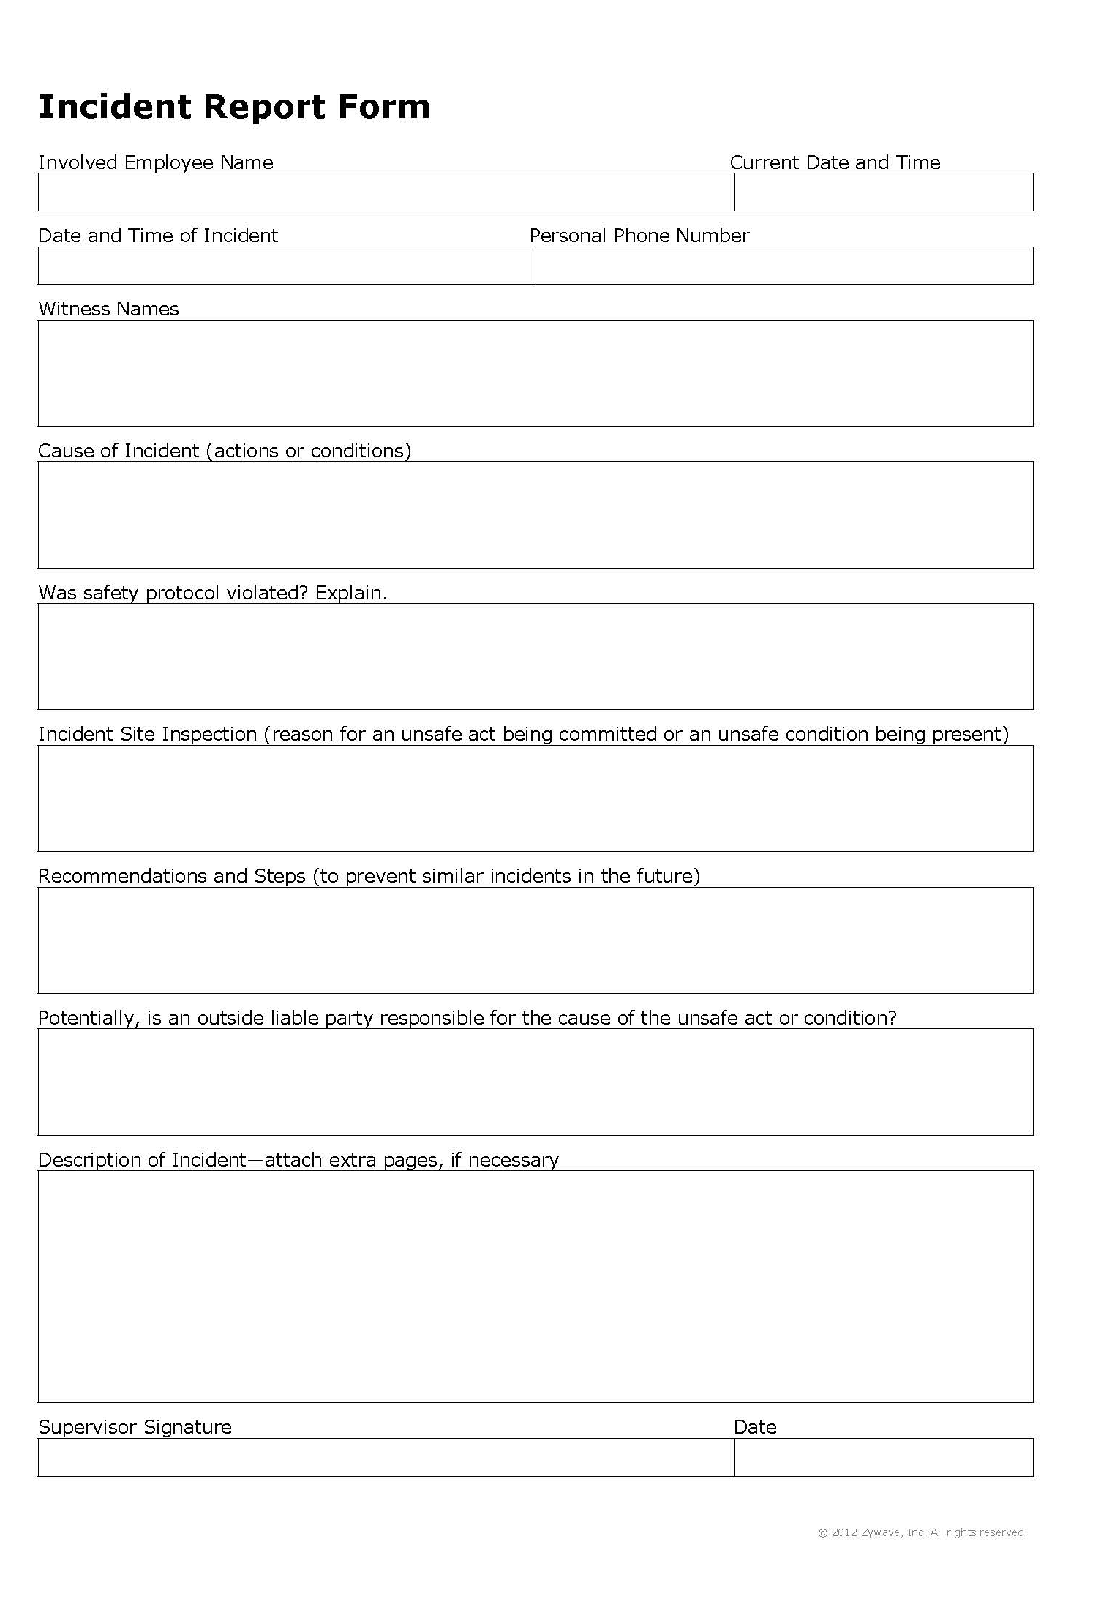
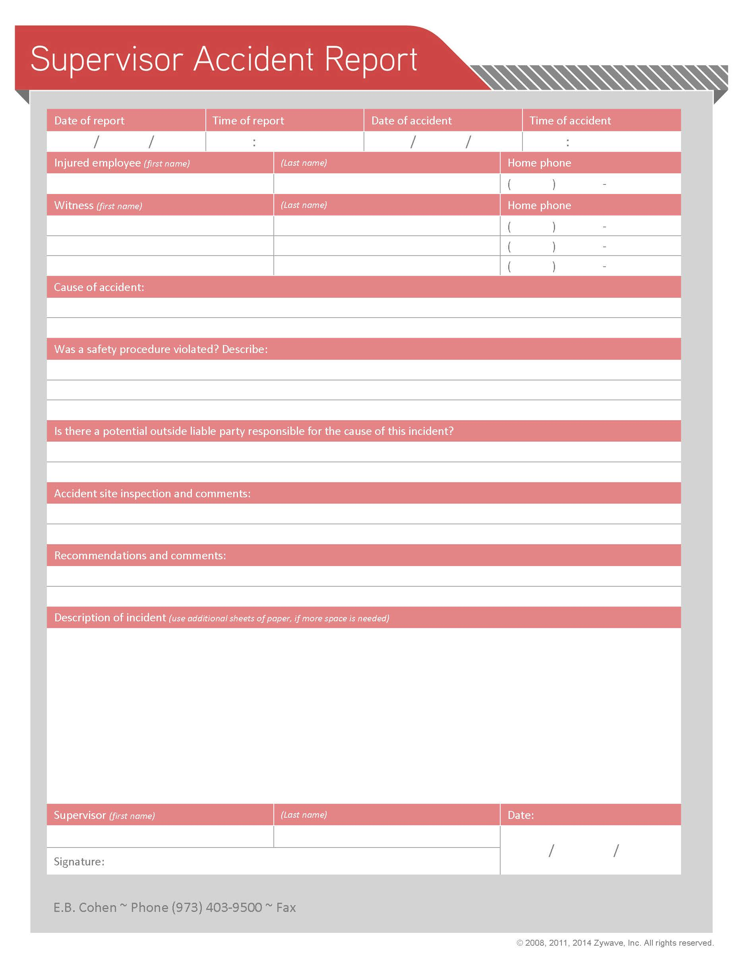
Incident/Accident Investigation continued
HOW
Use accident recording forms and an accident investigation kit to record the investigation and ensure you gather all necessary information.

Slide 32
Incident/Accident Investigation continued
AFTER THE INVESTIGATION
Provide copies of the forms used as well as any notes on the investigation to E.B. Cohen or your insurance carrier.
If the accident is OSHA recordable, enter it into your OSHA log.
Determine whether the situation or conditions that led to this accident exist anywhere else in the company.
If so, take action to correct this.
Use the accident as an opportunity to review safety procedures, personal protective equipment use or any other applicable training with your employees.

Slide 33
Incident/Accident Investigation continued
PURPOSE- Create a consistent and appropriate process for several reasons
Minimize liability – litigation can be expensive, and cases frequently settle when good facts are not available. A proper investigation can create a set of facts that can support a defense position’ during litigation. Set your insurance carrier up for success and minimize liabilities through this process.
Set up each file as if it were going to trial.
Duty under the policy to preserve evidence

Slide 34
Notification Responsibilities- WC
Most states have laws requiring that workplace injuries be reported timely.
In NY, workplace injuries are considered “reportable "if:
Due to the workplace injury, the employee misses more time than the shift that they were injured; or
More than two first aid treatments have ben administered for the same injury

Slide 35
Notification Responsibilities- WC continued
Reconciling using the First Aid Option with the Reporting Requirement
Having a strategy that utilizes the First Aid Option (available in many states including NY) can have many benefits including reducing an employer’s experience modification.
This strategy needs to be implemented with diligence and a qualified Claims Administration Manager.
The impact of workers’ compensation claims on premiums is direct and significant.

Slide 36
Notification Responsibilities
Notice to EPLI carrier in two circumstances:
When a Claim is First made
When there is knowledge of a circumstance
Claim First Made – defined under most policies as a written demand for money or a written administrative complaint or allegation.
Examples include: a letter of attorney representation; an email from an employee demanding compensation due to some alleged employment allegation; notice from EEOC regarding a discrimination complaint.
Most policies require notice to the carrier “as soon as practicable” which can mean within 30 days.

Slide 37
Notification Responsibilities continued
Notice to a broker does not mean the carrier was put on notice.
Pro Tip: forward the written document you received to your broker. Discuss with your broker the notice requirements. If the broker is putting the carrier on notice, request an acknowledgment from the carrier (the broker should provide) that they have been put on notice.

Slide 38
Notification Responsibilities continued
Failure to provide notice to the carrier can result in the denial of the claim due to late notice. In most jurisdictions, insurance law allows for carriers to deny on this basis for claims made policies.
Note: for occurrence type policies, in many jurisdictions, carriers may not deny based on late notice unless the carrier was prejudiced in their defense as a result of the late notice. Since most EPLI policies are claims made, the notice requirement is of importance, because carriers can use late notice as a basis for denying a claim.

Slide 39
Notification Responsibilities continued
Notice of a Circumstance
If an employer has knowledge of a circumstance that might give rise to a claim (aka Potential Circumstance), under most EPLI policies, a policyholder MAY, at its option, put the carrier on notice. There are advantages and disadvantages to do so.

Slide 40
Notification Responsibilities continued
Advantages of putting the carrier on notice of a circumstance
This satisfies the notice requirement and if subsequent litigation ensues, the policy terms, limits, deductibles that apply will be those of the policy that was in place at the time of notice. The advantage here is that future policy limits are preserved.
Avoids having to remember to disclose under the next renewal application since most applications ask this questions. Far too often a renewal application is completed by someone that either does not know or does not remember that a circumstance took place during the prior 12 months.

Slide 41
Notification Responsibilities continued
Disadvantages
The carrier is being put on notice of a matter that may not develop into a claim.
The listing of the matter may cause underwriting action upon renewal including increased premiums, increased deductibles, etc.
Pro tip: due to the dilemma that is created by circumstances that have not quite risen to the level of a Claim First Made, it is advisable to speak to both your attorney and insurance broker about whether notice is advisable. While the safest choice is to put the carrier on notice, depending on the severity of the matter and whether it can be resolved amicably, it may be strategic NOT to notify the carrier. Of course, great care must be taken on the subsequent application for insurance

Slide 42
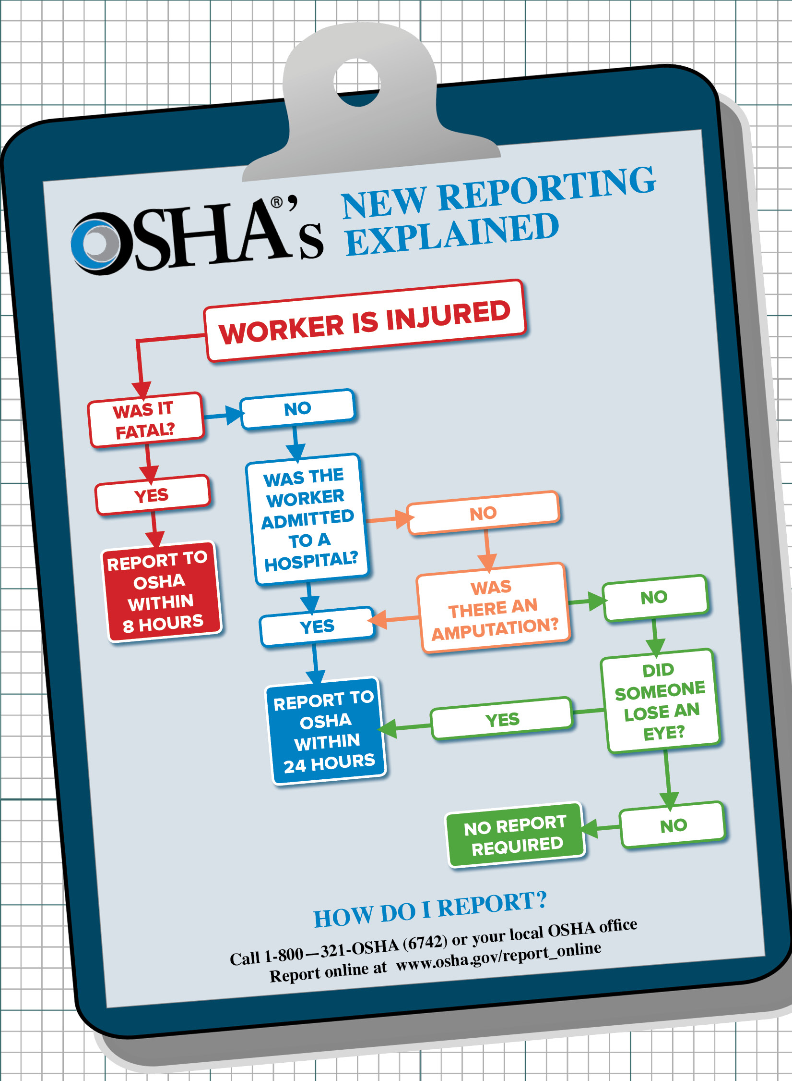
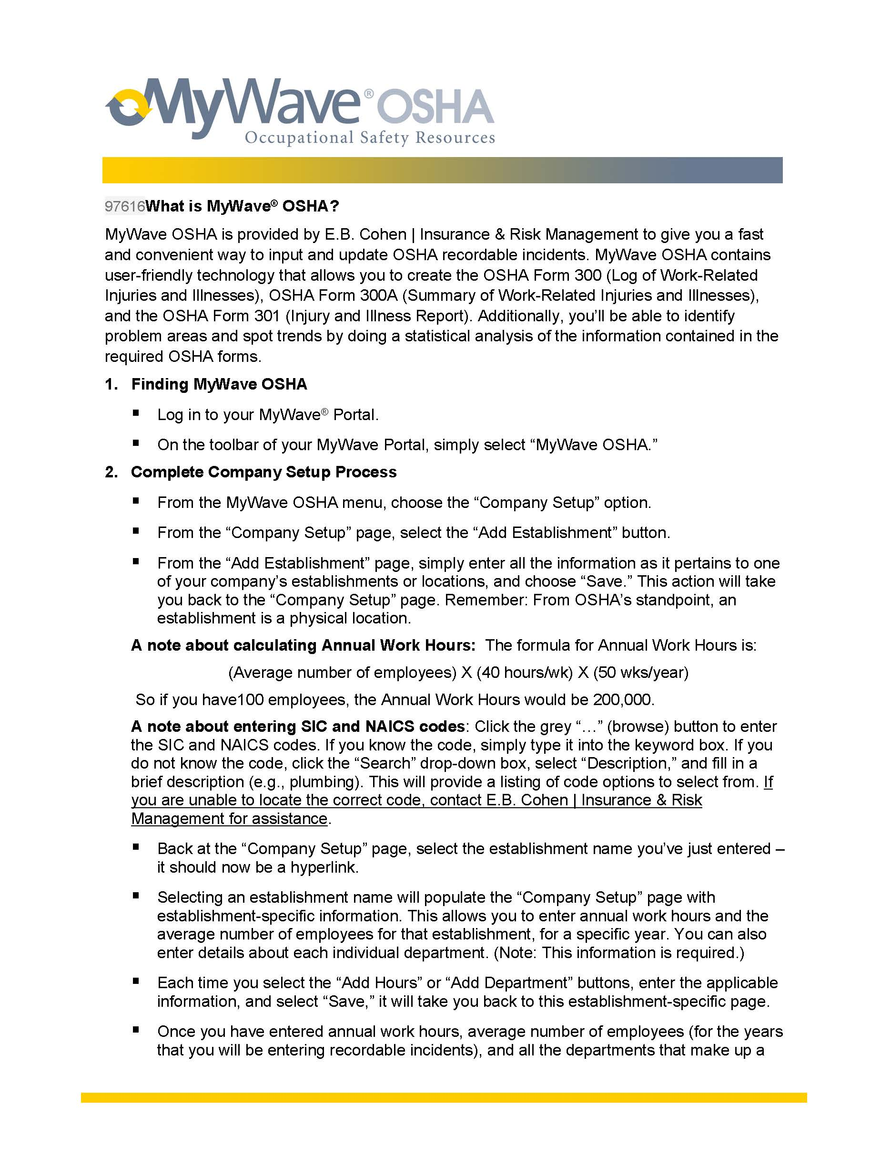
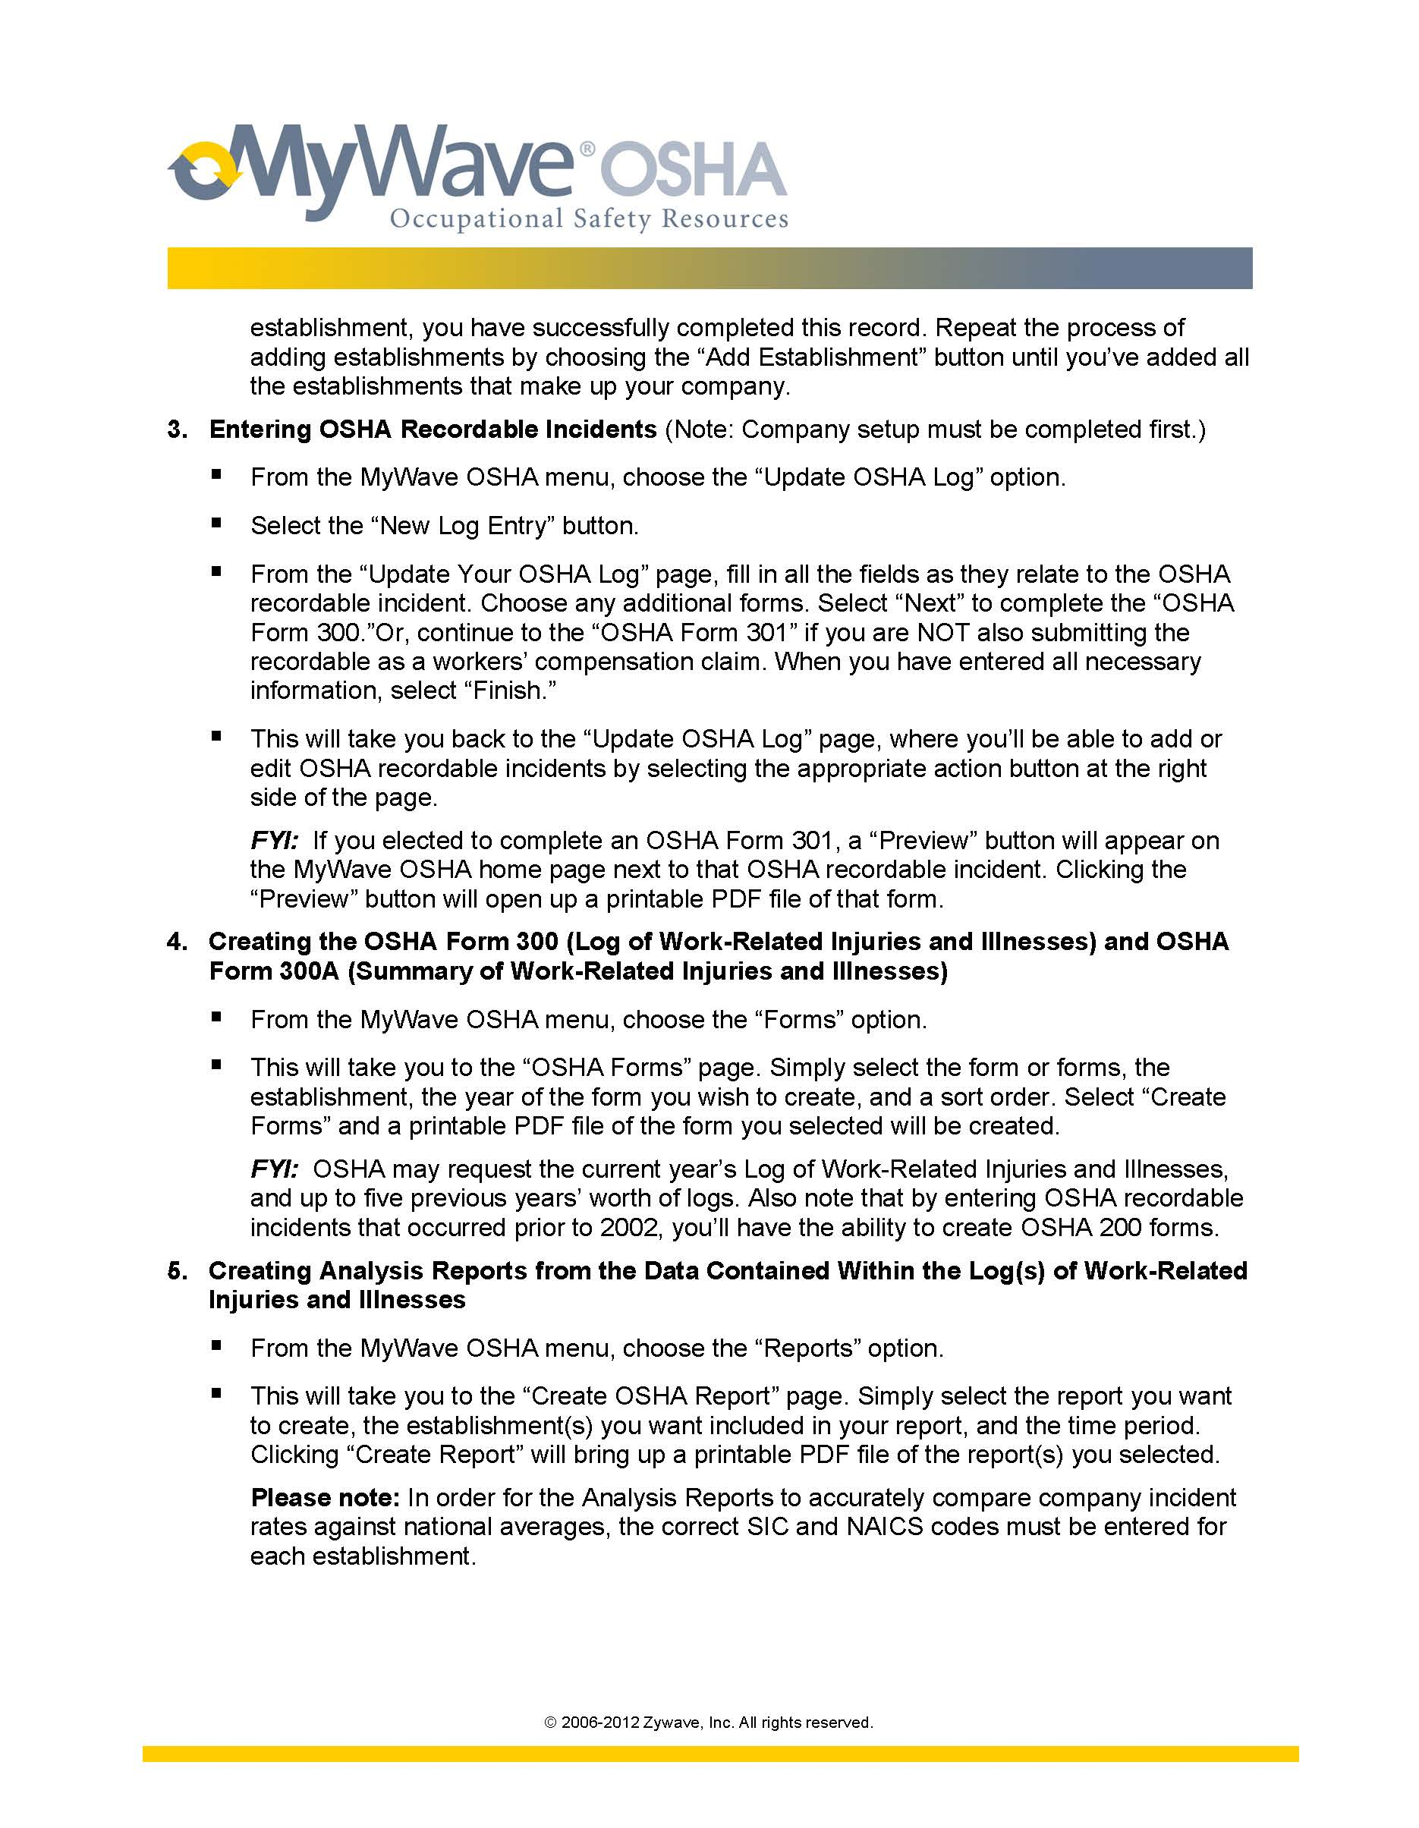
Notification Responsibilities OSHA
OSHA has various reporting and other requirements
OSHA serious injury notice
OSHA injury log reporting

Slide 43
Data Integrity: How to Protect Your People and Secure Electronic Data and Confidential Information.

Slide 44
Policies Involving the Use of Technology
Bring Your Own Device Program: (“BYOD”) Permits employees to connect their personal devices (e.g. laptops, smartphones, and tablets) to the business’s networks and systems to complete work-related duties.
vs.
Corporate Owned Personally Enabled Programs: (“COPE”) Companies purchase and provide
devices and network systems for employees.

Slide 45
Policies Involving the Use of Technology
The safest way to protect company data is to prohibit employees from working on personal devices.
But, is this practical in today’s technological environment? Probably not.
Instead, employers should consider utilizing a mobile device management (“MDM”) solution.
MDM software can monitor, manage and secure employees’ laptops, smartphones, tablets and other devices that are being used in the workplace.
Without MDM, information on stolen or lost devices is not secure, and has increased exposure to malware and other viruses that could compromise confidential data.

Slide 46
Protecting Your Data
Administrative Safeguards
Responsibility, access restrictions, training, contingency plans and sanctions.
Physical Safeguards
Limit facility access, workstation use/security, device and media controls.
Technical Safeguards.
Firewalls, encryption, passwords, termination procedures, audit controls, integrity of data.
Organizational safe guards.
Venders business units.

Slide 47
Protecting Your Data
Assess:
Standards for handling credit card or payment data;
Safeguards for other customer personal information;
Safeguards for employee/relative personal information.
Review vendor agreements.
What information/data is protected by vendors? How?

Slide 48
Policies, Procedures and Practices
Employee and third-party access rights
Security software updates
Backup systems
Monitor data transfers
Data Destruction
Telecommuting and remote devices
Phishing policy
Cyber security insurance coverage
Protect against cyberstalking

Slide 49
Data Breach Expense & Privacy Liability Insurance
Coverage for a business to pay the costs related to a breach of private information
Common First Party Expenses – these are the expenses a business is likely to incur after a breach but even without litigation
Forensic investigation
Notification and monitoring expenses
Data breach coach / legal advice expenses
Common Third-Party liabilities
Privacy liability

Slide 50
Employment Practices Liability Market Update

Slide 51
EPLI Market Update
Upward rate pressure in 2% - 10% range
Impact of litigation on renewal pricing
Increasing deductibles especially as organizations grow
Single location versus multi-location
Sub-limits for wage & hour type claims with coverage limited to defense costs only
One aggregate limit for entire policy even if multiple locations

Slide 52
EPLI Market Update – Underwriting Challenges
Social Initiatives putting pressure on businesses and increasing frequency of claims
Equal Compensation becoming an increasingly hot topic and driving additional litigation
Wage & Hour issues continue
The challenge of businesses and HR departments to keep up with trending legislative and other legal requirements is creating unexpected pitfalls that insurance companies now must charge additional premium for.

Slide 53
EPLI Market Update - Strategies for HR
Audit your procedures
Spend time on the application and supplemental materials to present your organization appropriately
Discuss legal representation preferences at the time of obtaining coverage
Discuss panel rates applicable for each carrier when obtaining quotes

Slide 54
Changes to the Law on Arbitration Agreements

Slide 55
New York Arbitration Agreements
2018 saw a substantial expansion of employers’ ability to enforce contractual arbitration agreements.
Most Important Arbitration Case for 2018: Epic Systems Corp. v. Lewis, 138 S. Ct. 1612 (2018) - The United States Supreme Court determined that agreements to waive the right to file a class action are enforceable.

Slide 56
New York Arbitration Agreements
Mandatory Arbitration
Prohibits mandatory arbitration of discrimination claims
But see Mahmoud Latif v. Morgan Stanley & Co. LLC, et al. (S.D.N.Y. 2019) (finding FAA’s strong presumption in favor of arbitration pre-empts inconsistent state laws imposing outright bans on arbitration agreements)
Non-Disclosure Agreements
Voids any nondisclosure clauses related to future claims of discrimination unless a worker is notified he or she can still talk to a reporting agencyDamages
Attorney fees
Punitive damages
Employer Liability/Defenses
Restricts employers’ ability to avoid liability for the behavior of their employees
The fact that an individual did not make a complaint about the harassment to their employer does not limit the employer’s liability

Slide 57
Questions?

